Slide 1
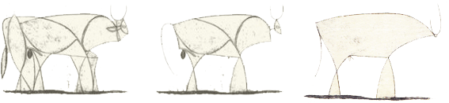
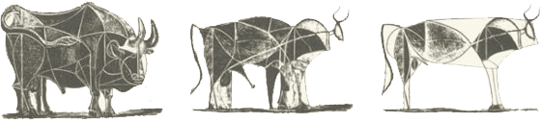
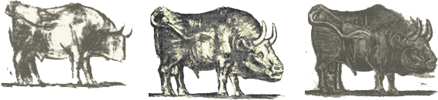
First course of Computer Science
Part VI: Operating System - history
Could we run a program without the support of OS?

Slide 2
Goals of this part
Know the evolution of Oss
Understand the requirements for Oss
Provide friendly interface for users
Manage the resources for the multitasked/multi-programmed programs/processes
Know the categories of Oss
Batch OS
Time-sharing OS
PC OS
…

Slide 3
Operating System
Evolution of Operating System
From simplicity to Complexity
Multiprogramming is the fundamental concept
Trend of providing friendly interface
Selected Oss
Mac OS
Windows

Slide 4
We have learned …
Concurrent Multiprogramming [并发的多道程序运行]
Also means the management of running those programs is more complicated [没有免费的午餐]
How to arrange those programs in the memory without interfering each other?
Once the CPU is idle, which stored program should be selected to get the authority of CPU?
How to guarantee the switching among the running programs turns all the results are correct?
If the devices are not enough to be shared by those stored programs, how to avoid the bad arrangement
Such as deadlock
…
We really need some mechanism to manage this complex situation!

Slide 5
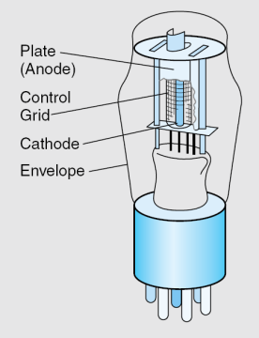
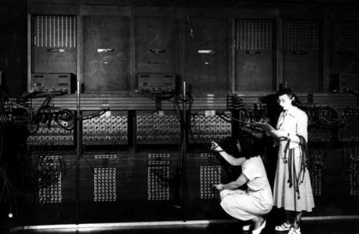
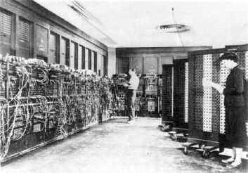
First generation 1945 - 1955
Technology: vacuum tubes & plug-boards
Programming: setting some switches
Programming language: machine language
Tasks: tables of sine, cosine, logarithms
OS: none
01.Operating system\PPTs.2011\PPTs from others\www.csee.usf.edu_~anda\www.csee.usf.edu_~anda_cop4600_lectures\lec01.ppt
Notes:
Not until World War II
Programs to grind out tables of sines, cosines, and logarithms.

Slide 6
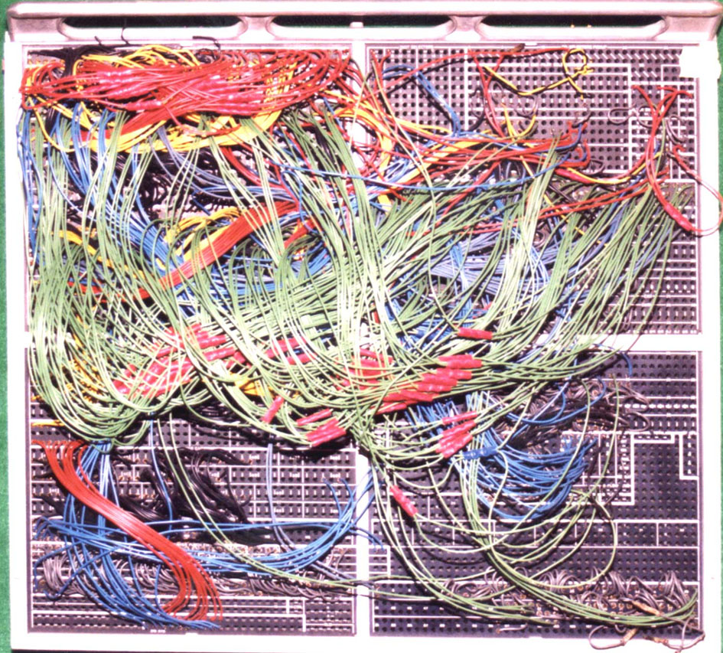
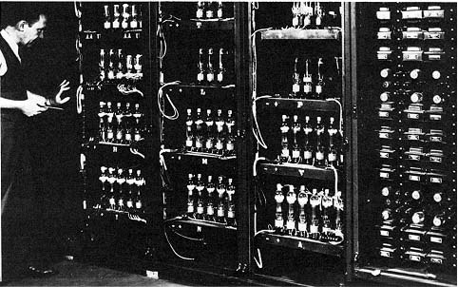
History of Operating Systems (1)
Computer designer is:
builder and
programmer and
operator and
“sys admin”
Programming in those days
01.Operating system\PPTs.2011\PPTs from others\www.csee.usf.edu_~anda\www.csee.usf.edu_~anda_cop4600_lectures\lec01.ppt
Notes:
Not until World War II
Programs to grind out tables of sines, cosines, and logarithms.

Slide 7
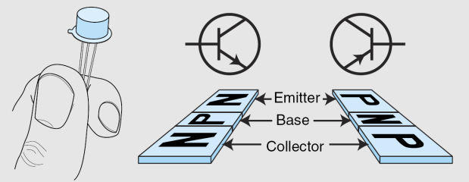
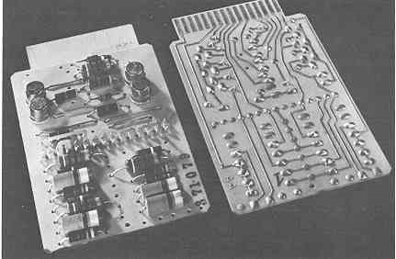
Second generation 1955 – 1965
Technology: Transistors
Programming: Punched cards
Programming languages: FORTRAN & Assembly
Tasks: Scientific
Computer: Mainframes
OS: Simple Batch system (SBS)
[Offline or Online]
01.Operating system\PPTs.2011\PPTs from others\www.csee.usf.edu_~anda\www.csee.usf.edu_~anda_cop4600_lectures\lec01.ppt
Notes:
Transistors changed the picture
Those computers called Mainframes, with pro operators to run them.

Slide 8
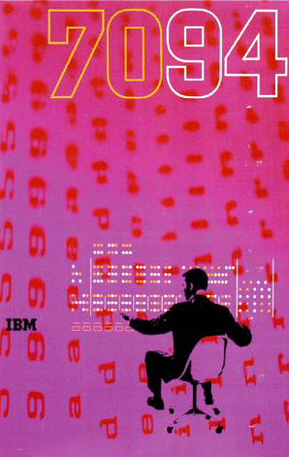
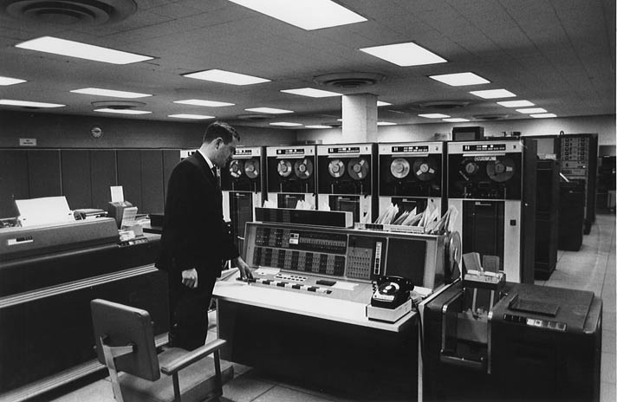
http://grainedit.com/2008/03/04/clarence-lee-ibm-poster/
During that period, the symbol of computers is IBM’s mainframe – IBM 7094
Tape drivers
CPU
Printer
Console
Card reader
http://www.columbia.edu/cu/computinghistory/1965.html

Slide 9
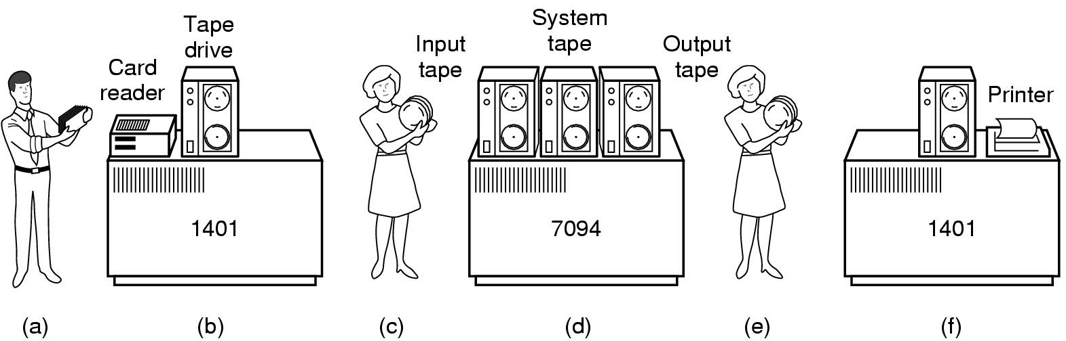
Early offline Simple Batch System (SBS)
bring cards to IBM 1401 machine (good at card reading)
read cards to tape
put tape on IBM 7094 which does computing
put tape on IBM 1401 which prints output offline
01.Operating system\PPTs.2011\PPTs from others\www.csee.usf.edu_~anda\www.csee.usf.edu_~anda_cop4600_lectures\lec01.ppt

Slide 10
IBM 7094 and its OS – FMS
The 7090 and 7094 were operated in batch mode, controlled by the Fortran Monitor System (FMS).
Batch jobs on cards were transferred to tape on an auxiliary 1401, and the monitor took one job at a time off the input tape, ran it, and captured the output on another tape for printing and punching by the 1401.
Each user job was loaded into core by the BSS loader (Binary Symbolic Segment loader) along with a small monitor routine that terminated jobs that ran over their time estimates.
Thus, each user's job had complete control of the whole 7094, all 32K words of memory, all the data channels, everything.
At that time, the major work is to run the Fortran programs. So the so-called OS is mainly used to control the running of the Fortran programs!
Later, IBM further proposed a “master monitor" (IBSYS) that included FMS as a subsystem

Slide 11
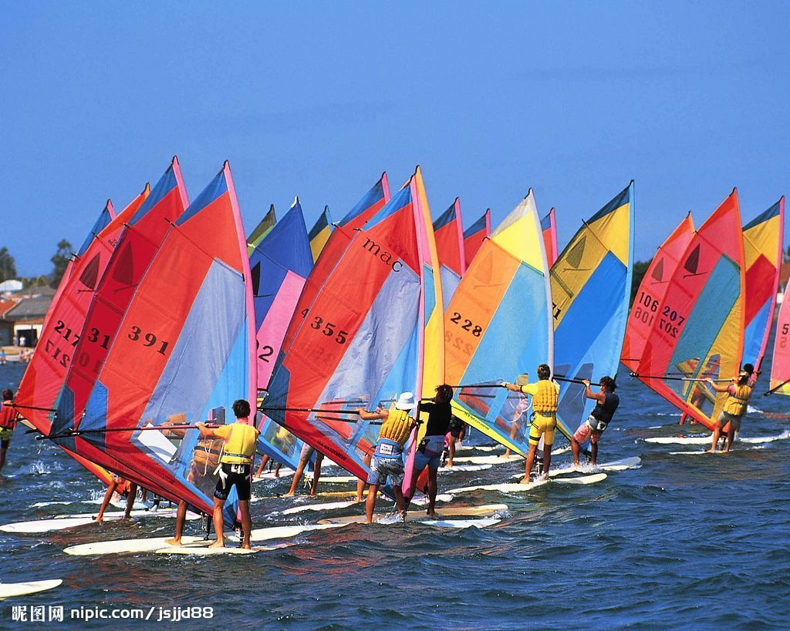
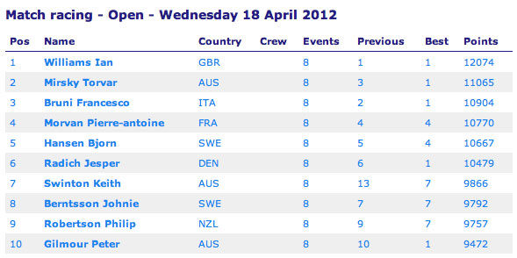
And IBM was smart then
It donated IBM 7094 to UM (Univ. of Michigan) and MIT
IBM’s managers required UM and MIT to stop their computing jobs on 7094 to finish match computing, because those managers liked sailing match very much!
http://uk.boats.com/boat-content/2012/04/ian-williams-and-anna-tunnicliffe-top-match-racing-table/

Slide 12
http://en.wikipedia.org/wiki/University_of_Michigan_Executive_System
UM provided UMES (University of Michigan Executive System)
To overcome that indignant requirement so that the intermediate result could be stored!
It's a more complex batch operating system developed at the University of Michigan in 1958, was widely used at many universities.
It was in use at the University of Michigan until 1967
Notes:
因为那个时候很难在程序执行中间停下来，将中间结果保留等以后再执行。只要停下来，就要从头再来.

Slide 13
IBM 7090/94 and IBSYS (1960)
http://en.wikipedia.org/wiki/IBM_7090/94_IBSYS
IBSYS was the tape based operating system that IBM supplied with its IBM 7090 and IBM 7094 computers.
IBSYS was based on FORTRAN Monitor System (FMS) and SHARE Operating System.
IBSYS itself was really a basic monitor program
read control card images placed between the decks of program and data cards of individual jobs.

Slide 14
FMS, UMES and IBSYS belong to so-called simple batch (process) system [单道批处理系统]
Two sub-types: offline and online
No matter which subtype, SBS can only store one job/program in computer’s main memory
All the resources are occupied by that job which is now in main memory!
This is a kind of waste: if there are many IO operations in that job, the CPU is idle!!
Multi-programmed batch (process) system
[多道批处理系统] and Time-sharing system

Slide 15
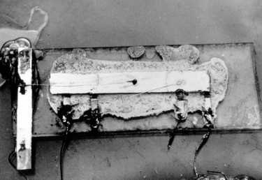
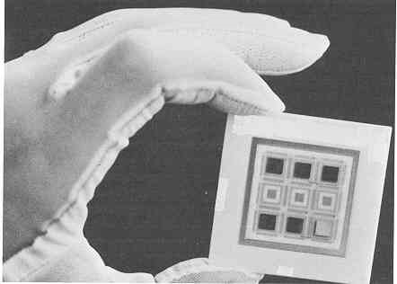
Third generation 1965 – 1980
Technology: Integrated circuits
Programming: Punched cards
Programming languages: FORTRAN & Assembly
Tasks: Scientific & commercial
Computers: IBM 360 (大型机), DEC PDPs (小型机)
OS: Multiprogramming/timesharing
01.Operating system\PPTs.2011\PPTs from others\www.csee.usf.edu_~anda\www.csee.usf.edu_~anda_cop4600_lectures\lec01.ppt

Slide 16
Multi-programmed systems
Multi-programmed batch system and Time-sharing system
To overcome the waste of SBS, we need some kind of multiplexing technique for main memory and parallelism between CPU and IO devices
Data channels, Interrupts: overlap I/O and compute
DMA – Direct Memory Access for I/O devices
I/O can be completed asynchronously
Multiprogramming: several programs run simultaneously
Small jobs not delayed by large jobs
More overlap between I/O and CPU
Need memory protection between programs and/or OS

Slide 17
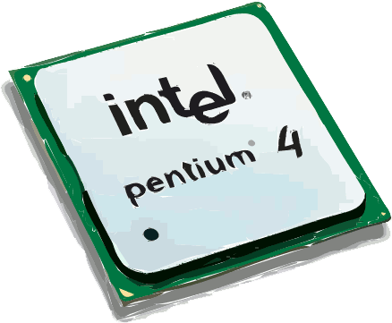
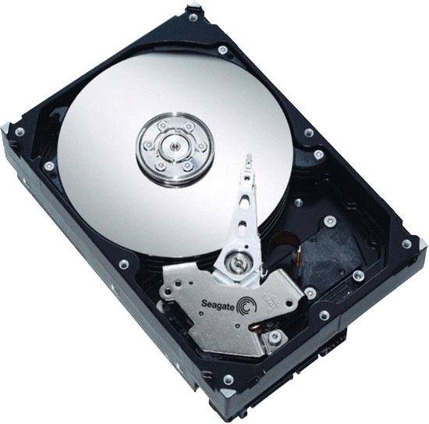
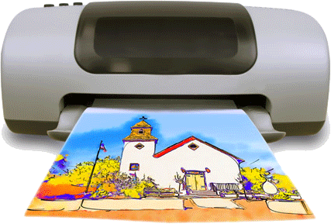
By multi-programming and parallelism (between CPU and IO), we can use the expensive CPU more efficiently.
IO1 req
IO2 req
A over
B over
A (4)
B (2)
A (6)
B (2)
CPU
IO1 over
CPU utilization = 14/16 = 0.875
IO1
IO2 over
IO2
0
4
6
8
13
14
16

Slide 18
Without multi-programming
A (4)
B (2)
A (6)
B (2)
CPU
IO
0
4
6
10
16
23
25
CPU utilization = 14/25 = 0.56

Slide 19
Compatible Time-Sharing System
http://en.wikipedia.org/wiki/Compatible_Time-Sharing_System
CTSS at MIT (1961)
The "Compatible" in the name refers to compatibility with the standard batch processing OS for the IBM 7094, the FORTRAN Monitor System (FMS)
CTSS ran an unaltered copy of FMS, processing a standard batch stream, in a pseudo-virtual 7094 provided by its background facility.
Background FMS jobs could access tapes normally, but could not interfere with foreground time-sharing processes or the resources used to support them.
CTSS used a modified IBM 7094 mainframe computer that supports two 32,768 36-bit word banks of core memory, up to 112 teleprinter terminals, two custom high speed vector graphics displays, IBM 729 tape drives and an IBM 1301 disk storage (later upgraded to an IBM 1302, with 38 million word capacity)

Slide 20
1962: MULTICS @ MIT
PPTs.2010\Part II Evolution of OS - Add.pptx
Ambitious project!
MULTiplexed Information and Computing Service
Goals of MULTICS
Provide service for all users in Boston city
Many terminals connected into (time-sharing) mainframes through phone lines
Support computing and time-sharing
Reliable huge file systems
Store data for so many users
Information sharing among users
Etc.
Regretfully, MULTICS was not implemented

Slide 21
PPTs.2010\Part II Evolution of OS - Add.pptx
Many properties of modern OSs were first proposed in MULTICS!
Segmentation (key technique for virtual memory later) was proposed
18 bits segment address and 16 bits offset
Multi-level tree structure for file system
Users can construct their own sub-directories
Could protect users’ files
Execution of each program (process later) was safe
Support multi-processor system

Slide 22
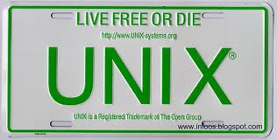
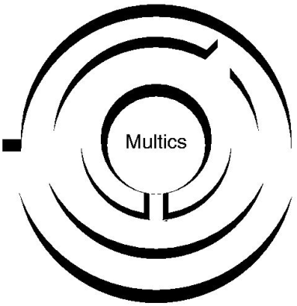
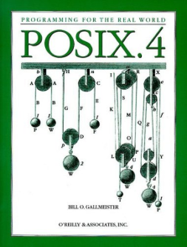


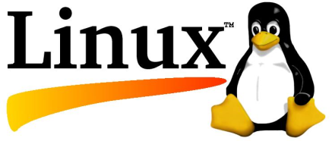
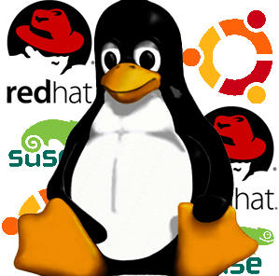
Multiprogramming/timesharing
OSes Developed:
CTSS
MULTICS (father of all modern OSs)
UNIX (System V, BSD…)
POSIX (Not an OS. for concurrency, by IEEE)
OpenBSD
MINIX (by Tanenbaum)
Linux
(originated by Linus Torvalds, inspired by MINIX)
http://www.minix3.org
01.Operating system\PPTs.2011\PPTs from others\www.csee.usf.edu_~anda\www.csee.usf.edu_~anda_cop4600_lectures\lec01.ppt

Slide 23
UNIX 1969
AT&T Bell Laboratories programmers Kenneth Thompson and Dennis Ritchie developed the UNIX operating system on a spare DEC minicomputer.
UNIX combined many of the timesharing and file management features offered by Multics, from which it took its name.
(Multics, a projects of the mid-1960s, represented the first effort at creating a multi-user, multi-tasking operating system.)
The UNIX operating system quickly secured a wide following, particularly among engineers and scientists.

Slide 24
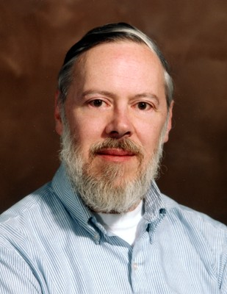
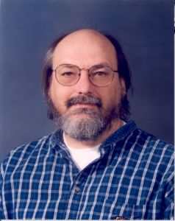
Dennis Ritchie
Ken Thompson
http://www.techcn.com.cn/index.php?doc-view-130701.html
They are also the cofounders of the HPL C, and the book they wrote about C programming is one of the most popular textbook

Slide 25
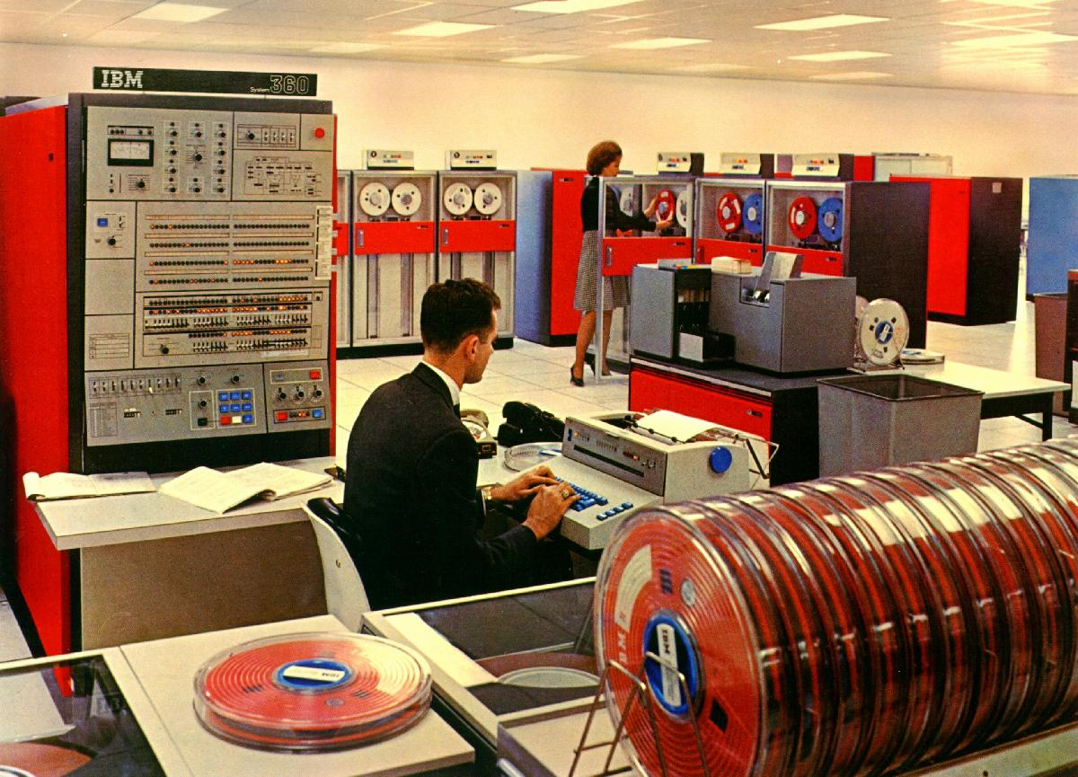
IBM 360
The whole system – mainframe (IBM360), input/output machine, and tape machine etc.
http://www.techcn.com.cn/index.php?doc-view-140320.html

Slide 26
IBM 360 and its OS – OS/306
The operating system planned for the System/360 was 'Operating System/360', or OS/360, announced in 1964. It was a batch processing operating system.
The name 360 was chosen to convey that a single system could support a full range of machines （three versions of the operating system existed--PCP， MFT and MVT）
PCP (Primary Control Program), a short-lived stop-gap which could run only one job at a time, in 1966;
MFT (Multiprogramming with Fixed number of Tasks) for the mid-range machines
MVT (Multiprogramming with Variable number of Tasks) for the top end.
The 360 system was unprecedented [无先例的,前所未闻的] in its ability to support a wide array of applications, and it was one of the first operating systems to require direct-access storage devices.
MFT and MVT were used until at least 1981
http://en.wikipedia.org/wiki/OS/360_and_successors
http://www-03.ibm.com/systems/z/os/zvse/about/history1960s.html

Slide 27
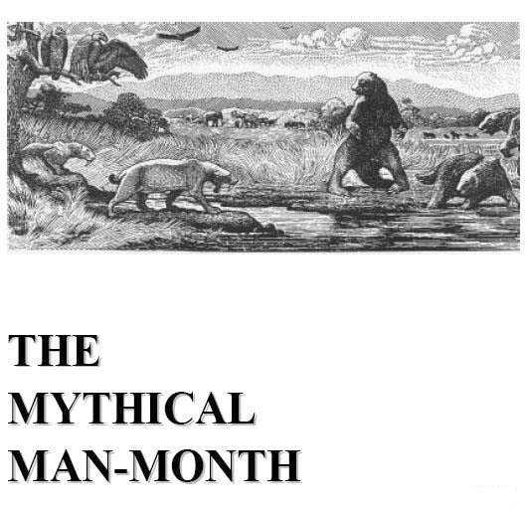
So-called software engineering is triggered by the development of IBM 360
The development of IBM System/360 is quite complicated
Frederick P.Brooks, the father of IBM 360, wrote a book
“The Mythical Man-Month (人月神话)”
Described the development complexity, and triggered the S.E
Adopting the engineering idea into the development of complicated software
http://www.techcn.com.cn/index.php?doc-view-140320.html

Slide 28
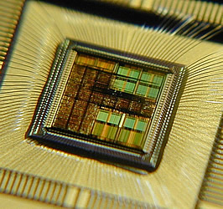
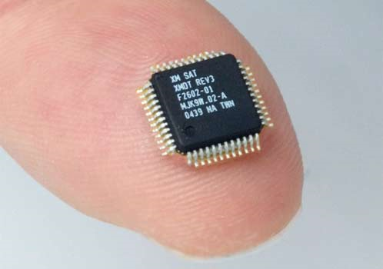
Fourth generation 1980-Present
Technology: VLSI
Programming: High level
Programming languages: C/C++, Java, ……
Computer: PC, super computers, embedded systems
OS:
Mainly PC OS: Windows, Mac OS, Linux …
But there are many other Oss, like Parallel OS, Distributed OS, Embedded OS …
01.Operating system\PPTs.2011\PPTs from others\www.csee.usf.edu_~anda\www.csee.usf.edu_~anda_cop4600_lectures\lec01.ppt

Slide 29
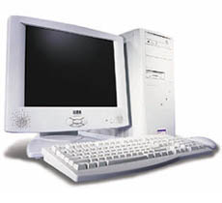
PPTs.2012\PPTs from others\+++Andy WANG\Principles of Operating Systems (Fall 2004)\lecture_1_introduction_and_history.ppt
Hardware: personal computers
OS design goal: allowing a user to perform many tasks at the same time
Multitasking: the ability to run multiple programs on the same machine at the same time
a single user can run multiple processes
Multiprocessing: the ability
to use multiple processors
on the same machine

Slide 30
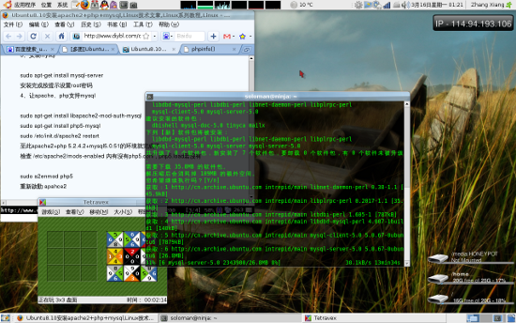
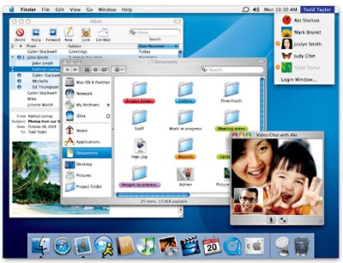
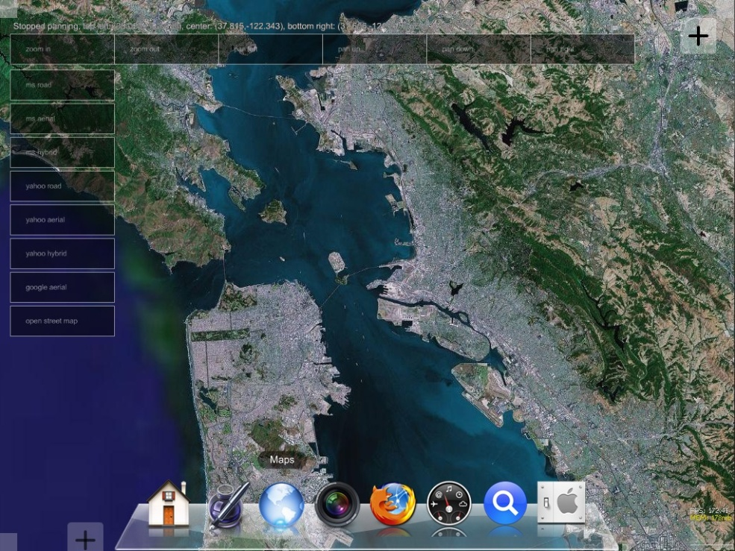
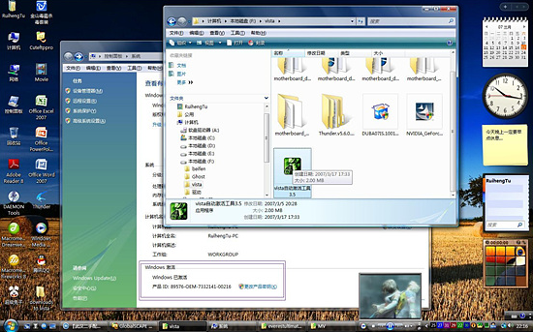
OS? OS! -GUI
Mac OS
Linux/Ubuntu 8.10
全手触控Mac OS X操作系统
Windows Vista
Notes:
In attempting to understand the key requirements for an OS and the significance of the major features of a contemporary OS, it is useful to consider how operating systems have evolved over the years.

Slide 31
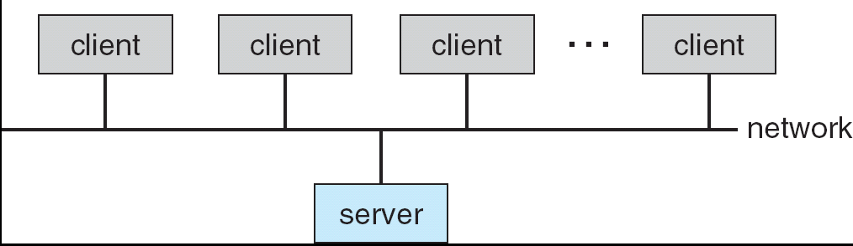
Distributed Systems (1989—)
Networking (Local Area Networking)
Different machines share resources
Printers, File Servers, Web Servers
Client – Server Model
Services
Computing
File Storage
Notes:
Why do we need distributed systems? Resource sharing (printers, Internet connections,…) and info sharing (files, email, IM, …)

Slide 32
Mobile Systems (1995—)
Ubiquitous Mobile Devices
Laptops, PDAs, phones
Small, portable, and inexpensive
Recently twice as many smart phones as PDAs
Many computers/person!
Limited capabilities (memory, CPU, power, etc…)
Wireless/Wide Area Networking
Leveraging the infrastructure
Huge distributed pool of resources extend devices
Traditional computers split into pieces. Wireless keyboards/mice, CPU distributed, storage remote
Peer-to-peer systems (P2P)
Many devices with equal responsibilities work together
Components of “Operating System” spread across globe

Slide 33
Evolution of an Operating Systems?
Must adapt to hardware upgrades and new types of hardware. Examples:
Character vs. graphic terminals
Introduction of paging hardware
Must offer new services, e.g., internet support.
The need to change the OS to place requirements on it’s design:
modular construction with clean interfaces.

Slide 34
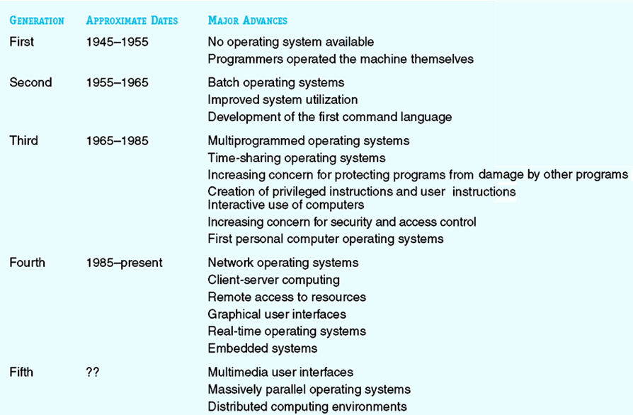
Some Major Advances in OS Development
PPTs.2010\PPTs from others\www.cs.hiram.edu_~oliphantlt_cpsc171_slides\lecture10.ppt

Slide 35
Operating System
Evolution of Operating System
From simplicity to Complexity
Multiprogramming is the fundamental concept
Trend of providing friendly interface
Selected Oss
Mac OS
Windows

Slide 36
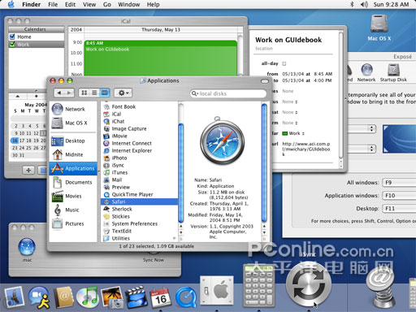
Mac OS is based on Unix
Apple is the first company to provide GUI style OS for commerce
Mac OS X Server is built on a fully compliant UNIX foundation. This battle-tested core provides the stability, performance, and security that organizations require. And full UNIX conformance ensures compatibility with existing server and application software. Mac OS X Server is the ideal platform for deploying groundbreaking enterprise applications and services.
http://www.apple.com/hk/en/server/macosx/technology/unix.html

Slide 37
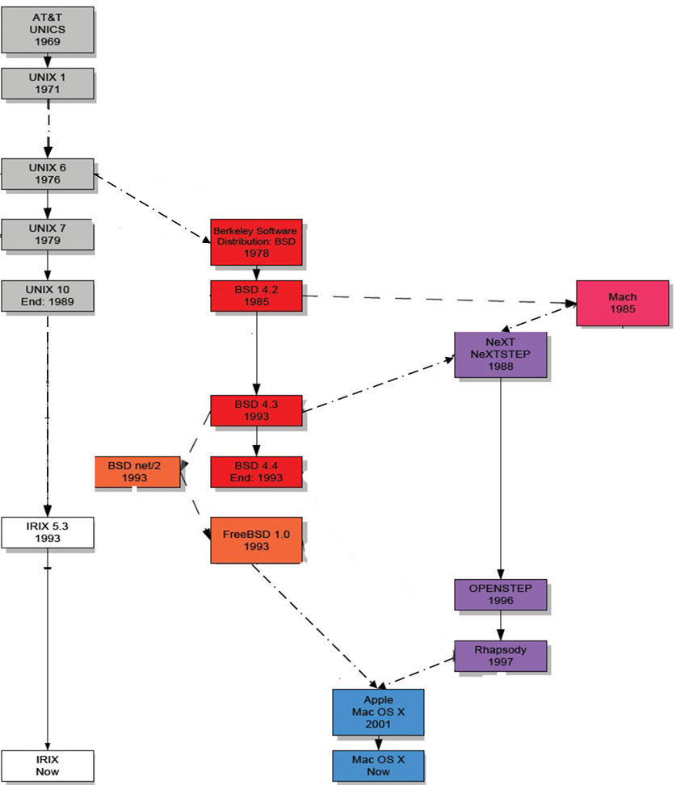
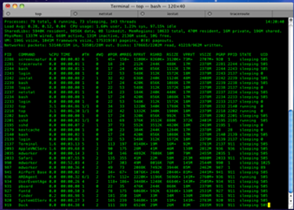
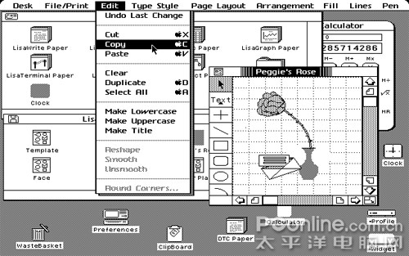
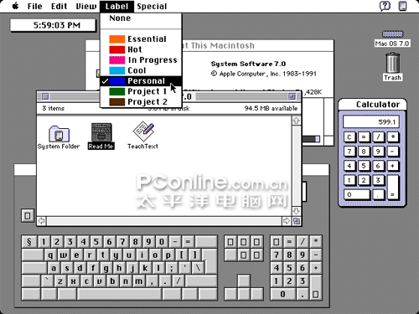
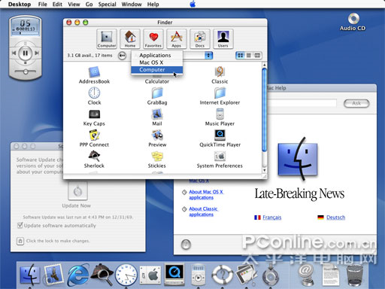
http://www.levenez.com/unix/
[Part III unix_history_en_de.pdf]

Slide 38
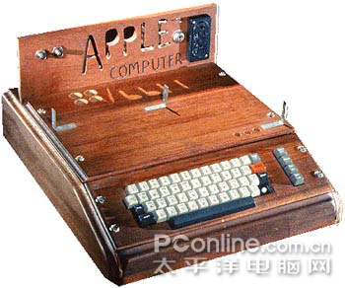
Apple I/II
1970s, the computer for common users was just a machine –inconvenient to use, even after 30 years of its invention
Steve Jobs is one of the guys who wanted to change this situation → Apple Company
The first success of Apple is the Apple II computer
At that time, the OS used for Apple I/II was command line style, and there was no mouse then – all operations are based on characters
http://www.pconline.com.cn/pcedu/soft/st/other/0508/694082_2.html

Slide 39
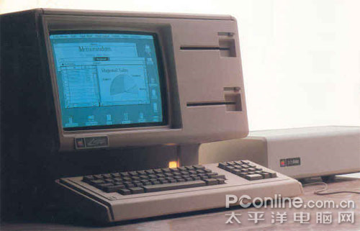
LISA: the first PC of using GUI style
During his visit in PARC (Palo Alto Research Center), Jobs met the Alto computer which was invented by the lab but was just for research – the inventers had not see its commercial value
Jobs was astonished by the quite new but friendly style, and decided the style of the OS used for his Lisa – The next PC
1983，LISA – the first GUI PC was proposed, and its price is $ 9998!

Slide 40
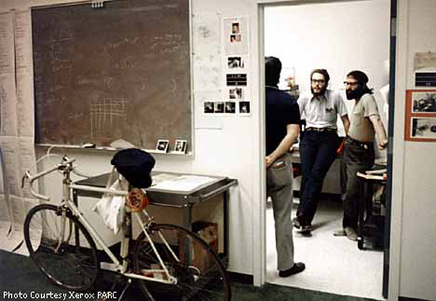
Xerox opens Palo Alto Research Center (PARC). In 1970, Xerox Corporation hired Dr. George Pake to lead a new research center in Palo Alto, California. PARC attracted some of the United States’ top computer scientists, and produced many groundbreaking inventions that transformed computing—most notably the personal computer graphical user interface, Ethernet, the laser printer, and object-oriented programming. Xerox was unable to market the inventions from PARC but others did, including Steve Jobs (Apple), Bob Metcalfe (3Com), as well as Charles Geschke and John Warnock (Adobe)
1970
Engineers at PARC circa 1972
PPTs.2010\Part III Computer architecture-FL02.pptx

Slide 41
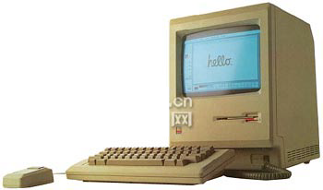
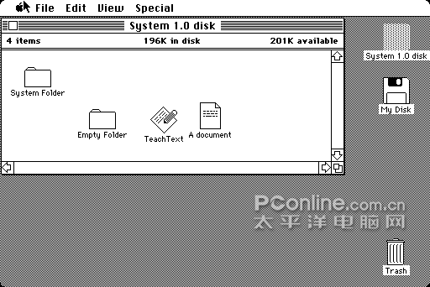
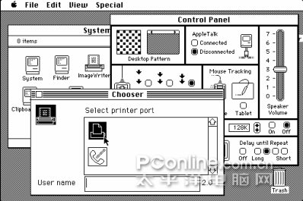

Macintosh: the classic PC
macintosh [ˈmækintɔʃ]
n. 橡皮布，橡皮布防水衣
1984, the Macintosh began for sale
The OS used for Macintosh was named System 1.0, which was only black & white
But most of the elements of the modern GUI OS were used, including desktop, window, icon, cursor, menu, scroll bar etc., even the Trash!
System 1.0
System 3.0
System 4.2

Slide 42
1991：Mac in color

Slide 43

1997: So called MAC OS begins
1997 summer, Apple published the epoch-making [划时代的] OS -- MAC OS 8（which also terminated the naming rules of System x.x）
In just two weeks, more than 1,250,000 MAC OS 8 were sold!
More colorful, supporting network, multimedia etc.

Slide 44
MAC OS X (2000)：a product of aestheticism
aestheticism [ˌi:sˈθetisizəm] n.唯美主义
Jan 2000 at San Francisco MacWorld, MAC OS X was first proposed
MAC OS X adopted a new kernel – Darwin, which is a variation of UNIX, and is quite stable
The most attractive characteristic of MAC OS X is the so-called Aqua GUI interface, which is still the peak of the user interfaces – fancy!

Slide 45
2004: MAC OS X 10.3 Panther[黑豹]
2004, MAC OS X 10.3 Panther（黑豹）was proposed, which adopted an important update, and is usually believed as the most interesting update
Update includes many new properties, such as quick user switch, iChat AV，and the new HI.
It’s the last version of integrating MS Internet Explorer
http://www.pconline.com.cn/pcedu/soft/st/other/0508/694082_7.html

Slide 46





Mac OS X 10.6 (2009)：the Snow Leopard
http://pcedu.pconline.com.cn/softnews/cs/0908/1773467_2.html
Dock & Stack
Preview
http://en.wikipedia.org/wiki/History_of_Mac_OS
Notes:
My first try of Mac OS X 10.6

Slide 47


Mac OS X 10.8 Mountain Lion (2012)

Slide 48
Operating System
Evolution of Operating System
From simplicity to Complexity
Multiprogramming is the fundamental concept
Trend of providing friendly interface
Selected Oss
Mac OS
Windows

Slide 49

"A History of Modern Computing" (2nd),Paul E. Ceruzzi, ISBN 0-262-53203-4. The MIT Press, 2003.
Microsoft Team, ca. 1978. This photograph shows Microsoft as it was moving from Albuquerque, where the Altair was built, to the Seattle area, where Bill Gates (lower left) and Paul Allen (lower right) were from. (Source: Microsoft.)

Slide 50


The beginning of MicroSoft
You have tried MS-DOS
Do you know the first Pot of Gold (第一桶金) for Gates?
The development tools for Basic!
In 1978, MicroSoft was still a small company that focused mainly on supplying programming languages for personal computers. (Source: Microsoft.)

Slide 51

Microsoft Windows History
1983: Windows 1.0
Many longtime PC users trace the Microsoft Windows® operating system to the 1990 release of Windows 3.0, the first widely popular version of Windows and the first version of Windows many PC users ever tried.
However, Microsoft initially announced the Windows product seven years earlier and released the first version in 1983.
The Windows 1.0 product box featured the operating system's new, tiled windows and graphical user interface (GUI).
http://www.windows.thiyagaraaj.com/

Slide 52

Microsoft Windows History
2007: Windows Vista
Windows Vista is a line of operating systems developed by Microsoft for use on personal computers, including home and business desktops, laptops, Tablet PCs, and media center PCs.
Prior to its announcement on July 22, 2005, Windows Vista was known by its codename Longhorn.
Development was completed on November 8, 2006; over the following three months it was released in stages to computer hardware and software manufacturers, business customers, and retail channels.
On January 30, 2007, it was released worldwide, and was made available for purchase and download from Microsoft's website.
The release of Windows Vista came more than five years after the introduction of its predecessor, Windows XP, the longest time span between successive releases of Microsoft Windows.

Slide 53

Microsoft Windows History
Windows 7
Windows 7 includes a number of new features, such as advances in touch, speech, and handwriting recognition, support for virtual hard disks, improved performance on multi-core processors, improved boot performance, and kernel improvements.
According to reports sent to TG Daily, the Milestone 1 build of Windows 7 adds support for systems using multiple heterogeneous graphics cards from different vendors and a new version of Windows Media Center.
New features in Milestone 1 also reportedly include Gadgets being integrated into Windows Explorer, a Gadget for Windows Media Center, the ability to visually pin and unpin items from the Start Menu and Taskbar, improved media features, the XPS Essentials Pack being integrated, Windows PowerShell Integrated Scripting Environment (ISE), and a multiline Calculator featuring Programmer andStatistics modes along with unit conversion.
Windows 7 (formerly codenamed Blackcomb and Vienna) is the next release of Microsoft Windows, an operating system produced by Microsoft for use on personal computers, including home and business desktops, laptops, Tablet PCs, and media center PCs.

Slide 54


Mac OS v.s Windows 7 v.s Ubuntu
More and more similar with each other in GUI

Slide 55

Mac OS v.s Windows 7 v.s Ubuntu
Of course they provide similar fundamental functions

Slide 56



Mac OS v.s Windows 7 v.s Ubuntu
Performance?
Mac OS & Ubuntu are both better than Windows 7 (Of course)
They are well-matched with each other
http://www.taranfx.com/windows-7-vs-ubuntu
http://reviews.cnet.com/8301-31012_7-10319612-10355804.html

Slide 57
Mac OS v.s Windows 7 v.s Ubuntu
For me
I have to use Windows 7
Benefitting from the “Piratical [盗版] strategy” of MS
I am trying Ubuntu
Excellent. But it’s still complicated in some settings
I love to try Mac OS later
It’s graceful, but some operations are against my habits which are trained from MS

